Slide 1
Lean Analysis for
Smart Border Development
A Systematic Approach
Zacheriah Cole
6 September 2018

Slide 2
The Investigation Process
Value Stream Mapping
Capacity & Waste Analysis
Simulation & Testing of Ideas
Value Proposition
Activities
Resources
Entities
Takt Time
Buffer Capacity
7 Types of Waste
Apply Lean & Agile Principles
Measure Impacts on Metrics
Evaluate Cost of Implementation vs Impact

Slide 3
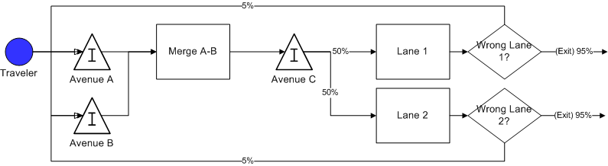
Value Stream Mapping
Consider the WHOLE system
Identify “Rework Loops”
Benchmark Takt Times

Slide 4
Capacity & Waste Analysis
Takt Time
Available Time vs Demanded Time
7 Types of Waste
Delay
Duplication
Unnecessary Movement
Unclear Communication
Incorrect “Inventory”
Opportunity Lost
Errors

Slide 5
Capacity & Waste Analysis
Example Flow Improvements
Clear communication early in process
  Signage and road paint
  Universal starting points
Triggers early in process
  Sensors to indicate queue size by traveler type
Flexibility to adjust resources
  Agile capability of lanes
  Agile capacity of lanes

Slide 6
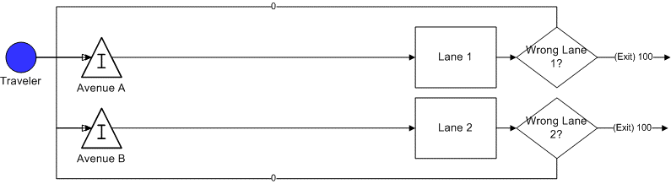
Simulation Example
Current State
Future State

Slide 7
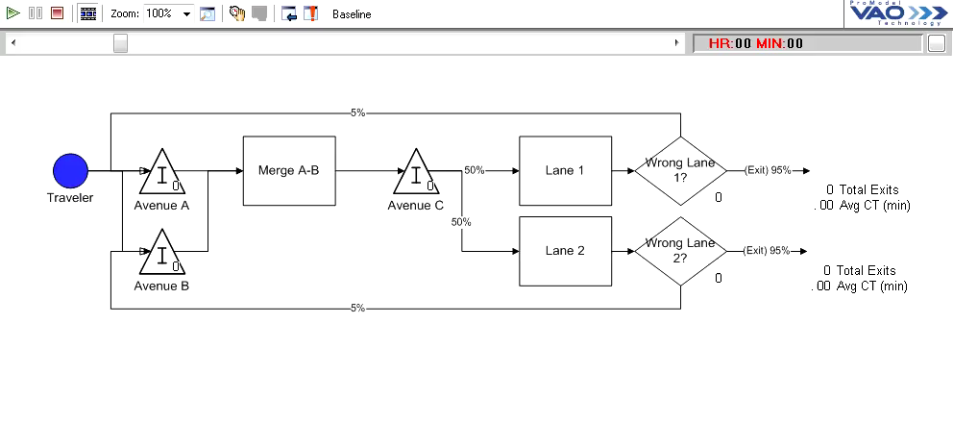
Simulation Example

Slide 8
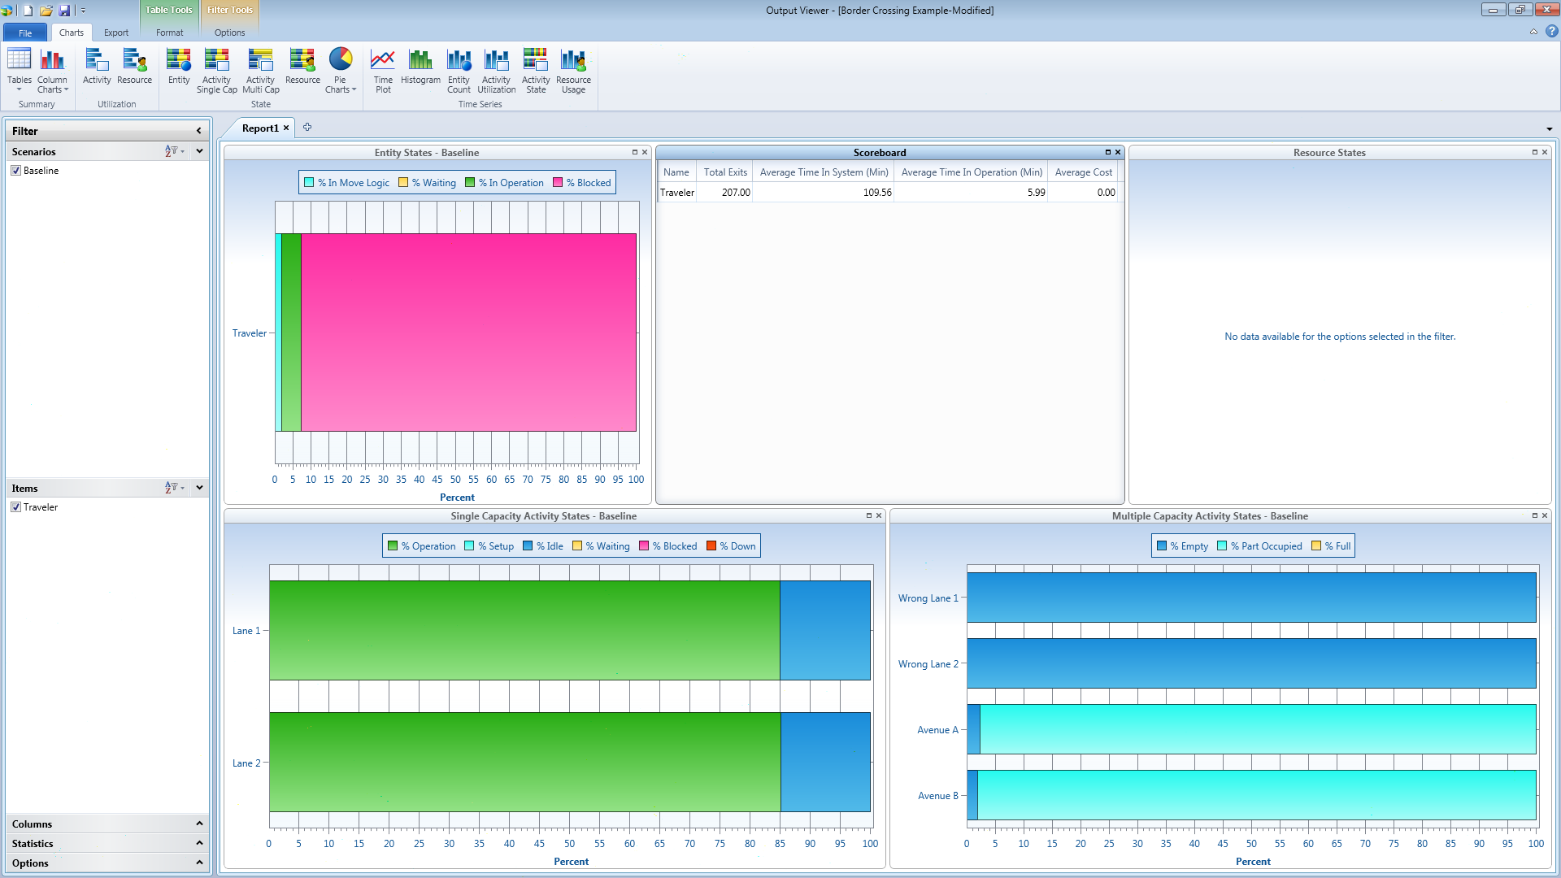
Simulation Example

Slide 9
Simulation Example
 | Current State | Future State
Average Time In System | 321 minutes | 109 minutes
Current State
Future State

Slide 10
Value Proposition
Evaluate cost of implementation for each change
Evaluate impact of implementation for each change
Build the fly wheel – start with biggest incremental impact vs cost of implementation
Layout stages of improvement and long term plan vs impact
Demonstrating wholistic and systematic vision is key to securing funding and resources

